Slide 1
Heart Failure Predictions
Predicting heart disease events.

Slide 2
Stakeholder
With the data provided by the stakeholder, I am making predictions on heart disease in persons using several attributes.

Slide 3
A brief introduction to the data
This dataset is a combination of independently available datasets that that were not combined before.
In this dataset we want to predict whether or not heart disease with occur in persons with some features that are provided.

Slide 4
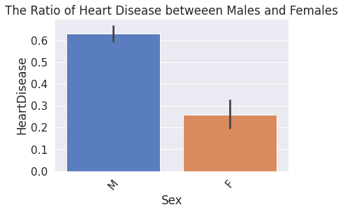
Data visuals
According to visual, there are a significantly more males than females with heart disease.

Slide 5
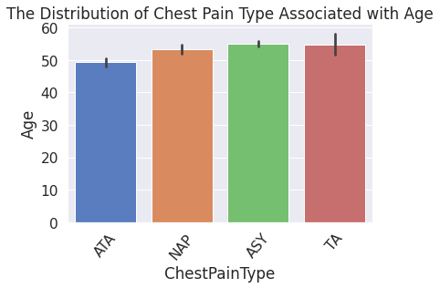
Data visual 2
According to this visual, persons who are 55 and over both experience the Asymptomatic and Atypical Angina (shortness of breath, discomfort in the throat, jaw, neck) pain type.

Slide 6
Strengths and weaknesses of the model

